Slide 1
Olist E-commerce Marketing Analytics
Federico Ariton

Slide 2
Project Overview
Simulates a real-world marketing analytics workflow
Simulates a real-world marketing analytics workflow
Source: Olist e-commerce dataset (CSV format)
Designed a relational database using QuickDB and implemented it in PostgreSQL
Built a full-stack pipeline using PostgreSQL, Python, and Strea
Initial focus: Product performance segmentation delivered through an interactive dashboard

Slide 3
About Olist
Brazilian e-commerce platform designed for small and medium-sized retailers
Connects sellers to major marketplaces like Amazon, Mercado Libre, and Magalu
Handles logistics, order fulfillment, and customer service on behalf of the sellers
Acts as a bridge between local businesses and large e-commerce ecosystems
Core mission: Simplify digital commerce and expand market reach for independent sellers

Slide 4
Database Design

Slide 5
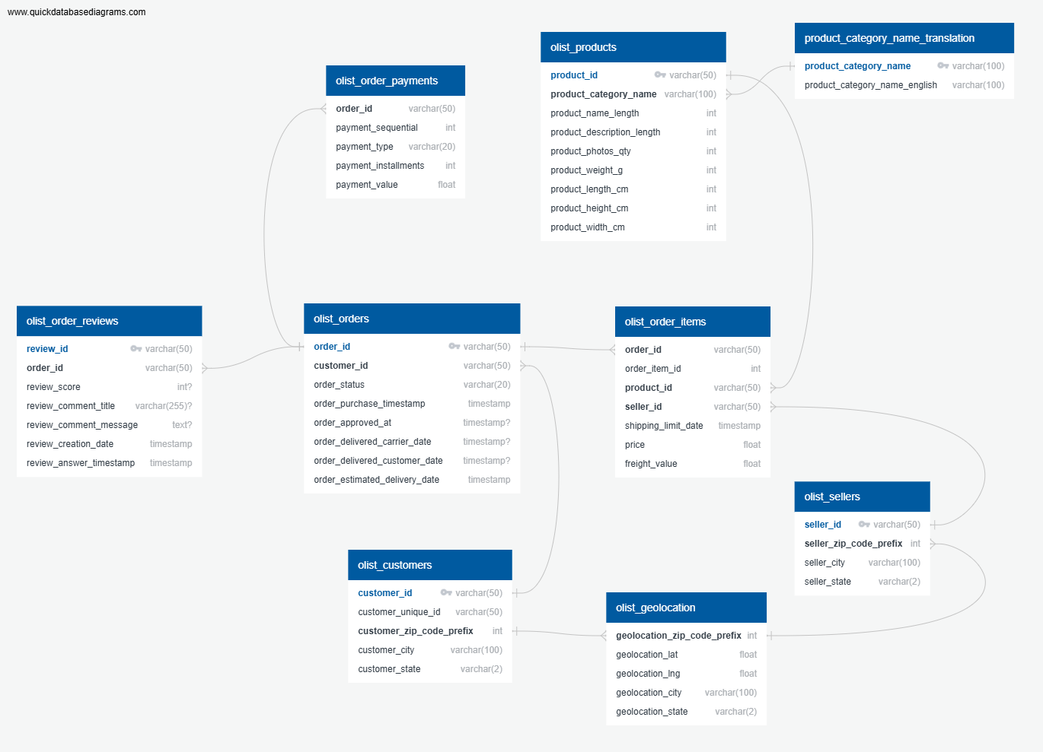
Database Design & ERD
Transformed raw CSVs into a normalized relational database schema
Using QuickDB and implemented in PostgreSQL
Designed to simulate real-world e-commerce systems
Benefits:
Referential integrity
Efficient querying
Realistic e-commerce architecture

Slide 6
Data Extraction & Processing
Connected to PostgreSQL using Python
Queried and joined data from orders, products, sellers, and reviews
Transformed the raw data into useful business indicator:
Sales volume per product
Revenue
Delivery delays
Review scores
The result: a clean and structured dataset ready for analysis and segmentation

Slide 7
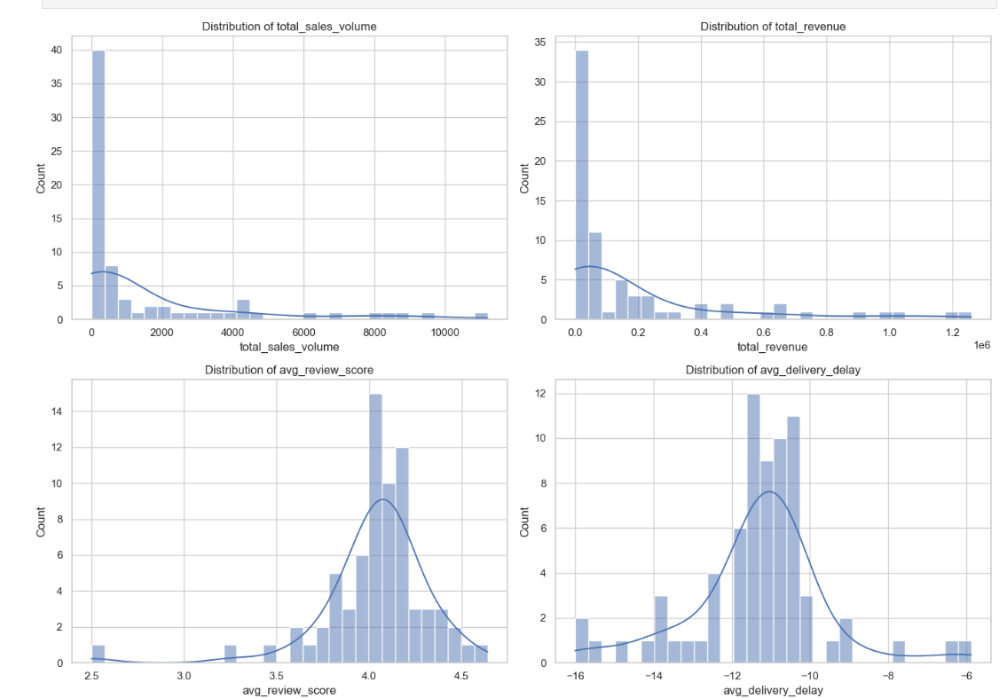
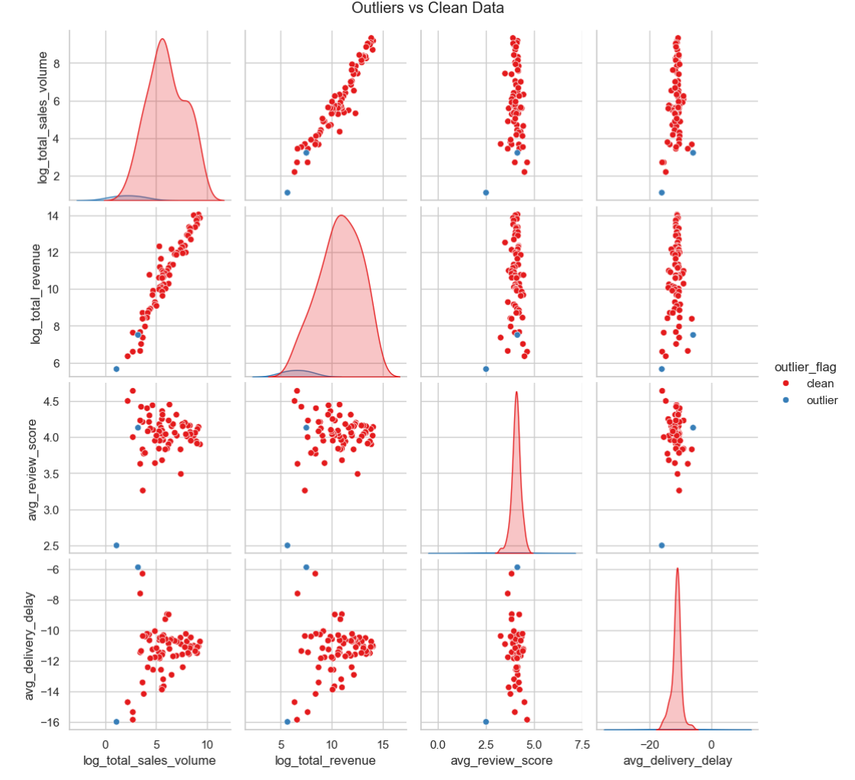
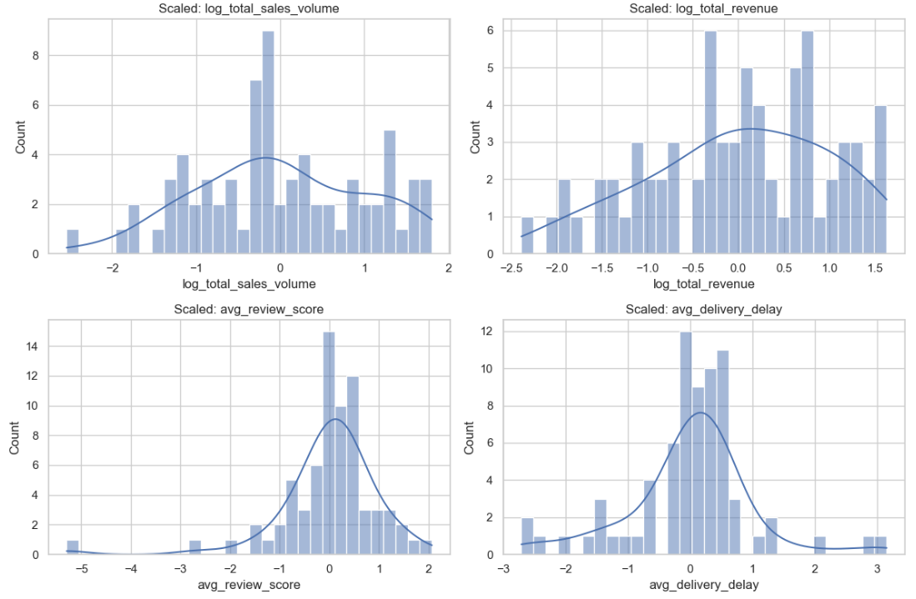
Feature Engineering for Clustering
Aggregated KPIs at category level:
Total sales volume
Total revenue
Average review score
Delivery delay
Applied:
Log transformations
Outlier removal (95th percentile)
Standardization (z-score)

Slide 8
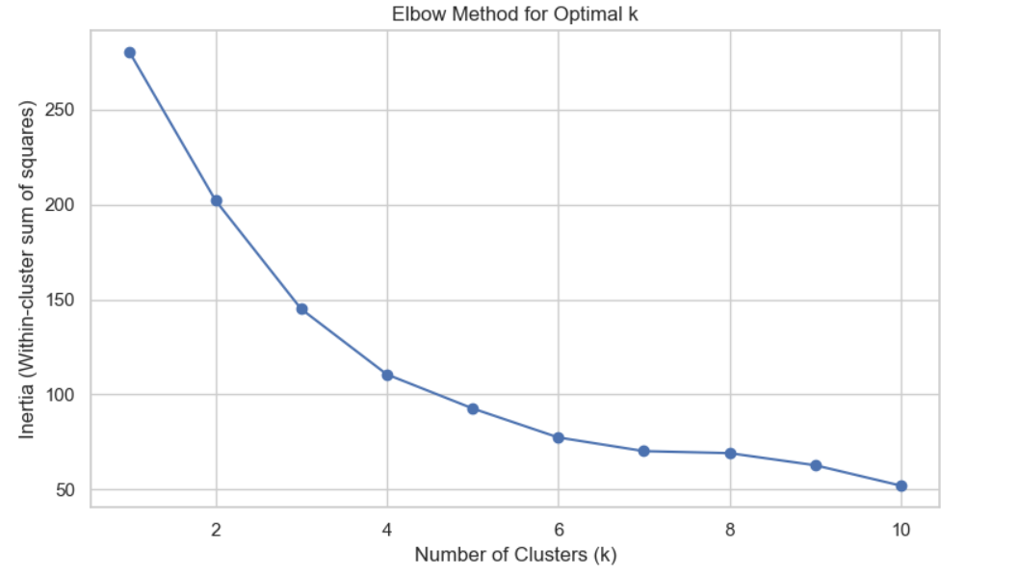
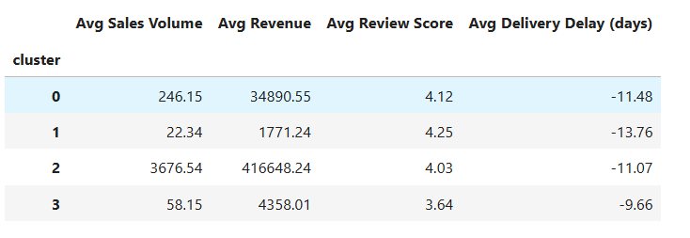
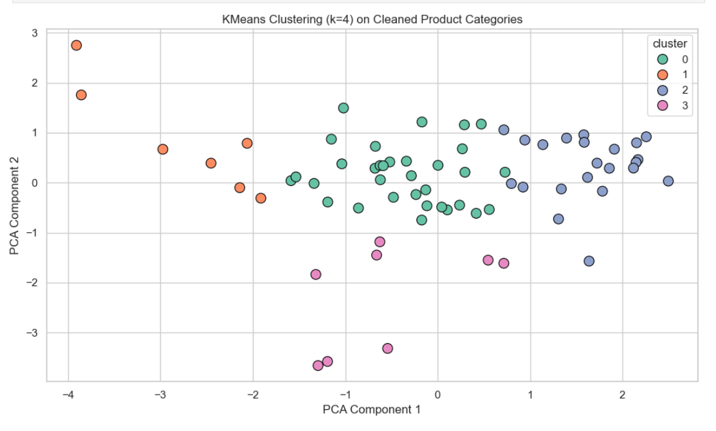
Dimensionality Reduction & Clustering
Applied PCA to reduce 4 features into 2 principal components for visualization
Elbow method selected optimal k = 4
Interpreted and labeled the clusters based on KPI averages:
Top Sellers
Reliable Performers
Niche Favorites
Underperformers

Slide 9

Marketing strategies
Segment | Strategic Action
Top Sellers | Optimize logistics and inventory
Reliable Performers | Promote visibility and maintain quality
Niche Favorites | Target loyal users with promotions
Underperformers | Investigate pricing, delivery, or product issues

Slide 10
Dashboard & Tech Stack
Dashboard (Streamlit)
Interactive cluster selection
KPIs per segment
CSV downloads
Tech Stack:
Python
PostgreSQL (Docker)
Streamlit
Plotly
QuickDB

Slide 11
Future Directions
Planned Next Steps:
CLV modeling
Churn prediction
CAC estimation
Sentiment analysis
Target segment identification
Advanced Enhancements:
A/B Testing Frameworks
Revenue Forecasting (SARIMA,LSTM)
Inventory Optimization

Slide 12
Thank you
Federico Ariton
+353 85 852 55 21| federicoariton22@gmail.com
www.federicoariton.com

